Slide 1


Pragna Moka
22-09-2024

Slide 2

Outline
Executive Summary
Introduction
Methodology
Results
Conclusion
Appendix

Slide 3
Executive Summary
Data on SpaceX launches, including variables like booster name, payload mass, orbit, and landing outcomes, was collected using GET requests and converted to a pandas DataFrame. Web scraping techniques with BeautifulSoup were used to extract additional data from HTML tables, which was then cleaned and wrangled for analysis. Missing values were handled, and exploratory data analysis was conducted to examine launch sites, orbits, and mission outcomes. SQL queries were employed to extract and filter data from relational databases for further insights. Visualization tools like Matplotlib and Seaborn were used to create charts for trend analysis. The analysis also explored SpaceX’s launch site locations using interactive Folium maps to assess the impact of geography on launch success rates. Additionally, a machine learning model was developed to predict the successful landing of the Falcon 9’s first stage, providing valuable insights for optimizing launch decisions and reducing costs.

Slide 4
Introduction
In this project we are trying to predict if the Falcon 9 first stage will land successfully or not. By using SpaceX data if we can determine if the first stage will land, we can determine the cost of a launch. This information can be used if an alternate company wants to bid against SpaceX for a rocket launch.
Objectives:
We will develop Python code to manipulate data in a Pandas data frame
Creating a Python Pandas data frame by converting a JSON file
Creating a Jupyter notebook and make it sharable using GitHub
Utilize data science methodologies
Utilize data analysis tools to load a dataset, clean it, and find out interesting insights from it.

Slide 5

Section 1

Slide 6
Methodology
Executive Summary
Data collection methodology: collected data such as booster name, longitude, latitude, payloadmass, orbit, landing outcomes, landing type and so on with the helper functions. Extracted the data with the GET request and converted to Json file using Pandas Dataframe. After that we have taken the required features and created the lists to create new dataframe and included on Falcon9 Launches to the table. Next found missing values using .mean(), .replace(), np.nan functions.
Perform data wrangling: Performed exploratory data analysis and determined training labels. Calculated number of launches on each site using value_counts() method and also number and occurrence of each orbit, mission outcome using .value_counts(). Then created outcomes where second stage did not land successfully.
Perform exploratory data analysis (EDA) using visualization and SQL: : Conducted EDA on various datasets, leveraging pandas for data manipulation and Matplotlib/Seaborn for data visualization. Key visualizations included line charts, bar plots, and scatter plots to analyze trends and patterns in datasets.
Perform interactive visual analytics using Folium and Plotly Dash: This analysis explores SpaceX's launch sites using interactive maps created with Folium. It aims to investigate the impact of geographic location on launch success rates, providing insights into how proximity and site characteristics could influence rocket launches.
Perform predictive analysis using classification models: A machine learning model is developed to predict the successful landing of Falcon 9’s first stage, a key factor in reducing launch costs. The model uses data from previous analyses to make predictions, helping SpaceX and potential competitors optimize launch decisions and costs.

Slide 7
Data Collection
GET Request:
Data was initially collected through an HTTP GET request from SpaceX’s public API.
Data Conversion to JSON:
The response from the GET request was converted into JSON format for ease of processing.
Pandas DataFrame Creation:
The JSON data was loaded into a pandas DataFrame for structured analysis.
Feature Selection:
Key features were selected from the DataFrame, such as booster name, longitude, latitude, payload mass, orbit, landing outcomes, and landing type.
Handling Missing Data:
Missing values were identified using functions like .isnull(), and handled by replacing them with the mean or a default value using .replace() or np.nan.
List Creation for New DataFrame:
Lists were created for the selected features, focusing specifically on Falcon 9 launches.

Slide 8
Data Collection – SpaceX API
GET Request to API(Data request to SpaceX API)
New DataFrame Construction:
A new DataFrame was constructed from the cleaned and processed data.
Final Data Preparation:
The data was finalized with all necessary columns, and further ready for analysis and exploration.
Add the GitHub URL of the completed SpaceX API calls notebook (must include completed code cell and outcome cell), as an external reference and peer-review purpose
Convert Response to JSON(Parse and load JSON)
Create Pandas DataFrame(Structure the data)
Select Key Features (Booster, orbit, payload mass, etc)
Handle Missing Data
Handle Missing Data (Replace with mean or np.nan)
Create Lists for Key Features(Filter Falcon 9 data)
Construct New DataFrame(Clean and final dataset)
Data Ready for Analysis (Proceed to EDA, wrangling)

Slide 9
Data Collection - Scraping
Send HTTP Request
Create a BeautifulSoup Object
Extract Table Headers
Create an Empty Dictionary
Extract Table Rows
Parse and Clean Data
Populate Dictionary
Create Pandas DataFrame
Add the GitHub URL of the completed web scraping notebook, as an external reference and peer-review purpose
Send HTTP Request
Create a BeautifulSoup Object
Extract Table Headers
Create an Empty Dictionary
Extract Table Rows
Parse and Clean Data
Populate Dictionary
Create Pandas DataFrame

Slide 10
Data Wrangling
Data Collection Sources: CSV files, APIs, databases
Data Cleaning Missing Values: dropna(), fillna() Duplicates: drop_duplicates() Data Types: astype() Standardization: String manipulations
Data Transformation Feature Engineering: Create new features (e.g., extract year) Scaling: MinMaxScaler, StandardScaler Encoding: OneHotEncoder, LabelEncoder
Exploratory Data Analysis (EDA) Statistics: describe(), info() Visualizations: Histograms, box plots Trends: Correlation analysis
Preparing Training Labels Label Creation: Define target variables Balancing Classes: Oversampling or undersampling
Finalizing Dataset Data Split: Train-test split Save Data: Export to CSV or database

Slide 11
EDA with Data Visualization
Descriptive Statistics Used describe() and info() for summary statistics (mean, median, etc.).
Data Visualization
Histograms: Show distribution of numerical features; identify skewness and outliers.
Box Plots: Visualize spread and detect outliers in continuous variables.
Scatter Plots: Analyze relationships between two numerical variables; identify correlations.
Line Charts: Track trends over time (e.g., sales trends). Bar Plots: Compare categorical variables (e.g., launches per site).
Distribution Analysis: Histograms and box plots for understanding data spread. Relationship Insights: Scatter plots for visualizing correlations. Trend Tracking: Line charts for time-series analysis. Group Comparison: Bar plots for comparing categorical data
Add the GitHub URL of your completed EDA with data visualization notebook, as an external reference and peer-review purpose

Slide 12
EDA with SQL
Data Retrieval Used SELECT statements to extract relevant data from tables.
Descriptive Analysis Employed COUNT(), SUM(), AVG(), and other aggregate functions to summarize data. Utilized GROUP BY to categorize data and analyze metrics per group (e.g., launches per site).
Filtering Data Used WHERE clauses to focus on specific subsets of data (e.g., filtering by launch success).
Identifying Trends Implemented ORDER BY to sort results (e.g., sales over time). Used JOIN operations to combine data from multiple tables for a comprehensive view.
Visualizing Results Exported query results for visualization in tools like Matplotlib or Seaborn to identify patterns.
Add the GitHub URL of your completed EDA with SQL notebook, as an external reference and peer-review purpose

Slide 13
Build an Interactive Map with Folium
Map Objects Created
Markers
Plotted markers at each launch site to indicate their geographic locations. Each marker included pop-ups with details like site names and total launches.
Circles
Added circles around launch sites to represent areas of influence or coverage, helping visualize the proximity to major population centers or other relevant geographic features.
Lines
Drew lines to represent flight paths of launches, illustrating the trajectories taken by rockets from different sites. This helps visualize the geographical context of launch operations.
Marker Clusters
Used marker clusters to group nearby launch sites, improving map readability and allowing users to zoom in on areas with multiple launches.
Add the GitHub URL of your completed interactive map with Folium map, as an external reference and peer-review purpose

Slide 14
Predictive Analysis (Classification)
I began by preparing the data, selecting key features (e.g., booster name, payload mass, orbit), applying feature scaling, and splitting the dataset into training and testing sets. We evaluated several models, including Logistic Regression, Random Forest, and SVM, using cross-validation to avoid overfitting. Performance was assessed using metrics such as accuracy, precision, recall, and the confusion matrix. After initial evaluations, we performed hyperparameter tuning with Grid Search to improve model performance. The best-performing model, a tuned Random Forest, was validated on the test set, achieving improved precision and recall, which reduced false positives and negatives.
Add the GitHub URL of your completed predictive analysis lab, as an external reference and peer-review purpose

Slide 15
Results
Exploratory Data Analysis Results
Through exploratory data analysis (EDA), we examined key patterns and trends in the dataset. Using visualizations such as line charts, bar plots, and scatter plots, we identified variations in launch success rates based on geographic locations and payload mass. The analysis revealed that certain launch sites had higher success rates, and the payload mass was inversely related to the success of first-stage landings. Additionally, categorical features like orbit and booster version significantly influenced the landing outcomes. Data wrangling also showed the distribution of successful versus unsuccessful launches across different orbits and time periods.
Predictive Analysis Results
In the predictive analysis, we built a classification model to predict Falcon 9’s first-stage landing success. After evaluating various models, including Logistic Regression, Random Forest, and SVM, the Random Forest model showed the best performance. By tuning hyperparameters via Grid Search, the model achieved high accuracy, precision, and recall, with a significant reduction in false negatives. The final model's performance on the test set confirmed its reliability in predicting landing success, helping optimize decision-making for future launches.

Slide 16

Section 2

Slide 17
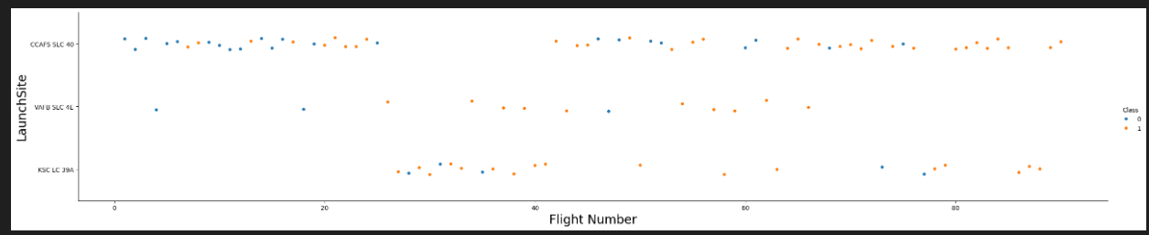
Flight Number vs. Launch Site
scatter plot of Flight Number vs. Launch Site

Slide 18
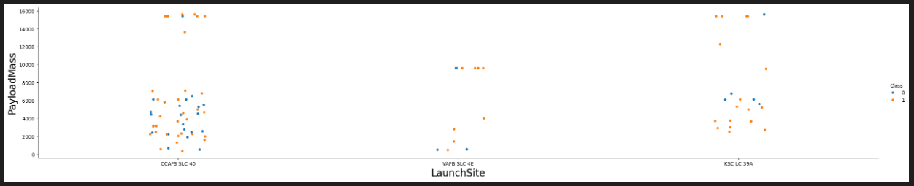
Payload vs. Launch Site
scatter plot of Payload vs. Launch Site

Slide 19
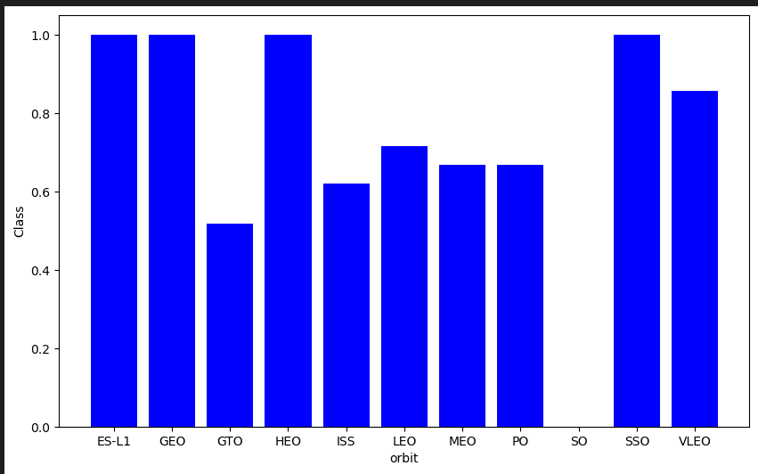
Success Rate vs. Orbit Type
bar chart for the success rate of each orbit type

Slide 20
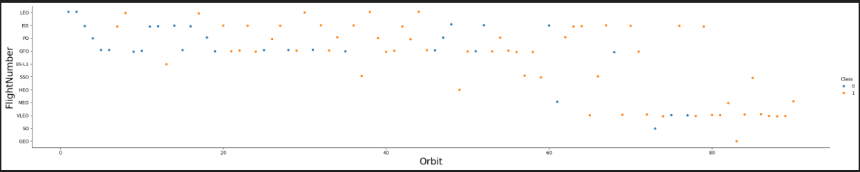
Flight Number vs. Orbit Type
Show a scatter point of Flight number vs. Orbit type

Slide 21
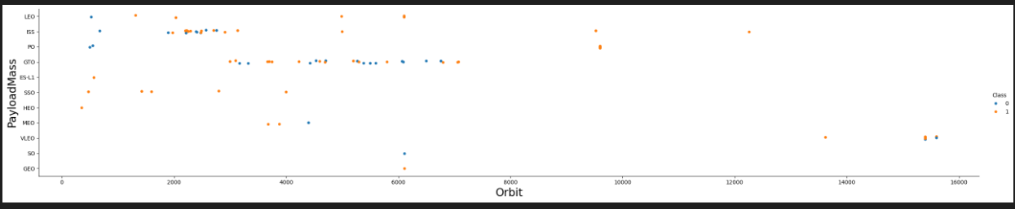
Payload vs. Orbit Type
Show a scatter point of payload vs. orbit type

Slide 22
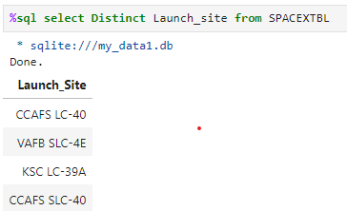
All Launch Site Names
unique launch sites

Slide 23
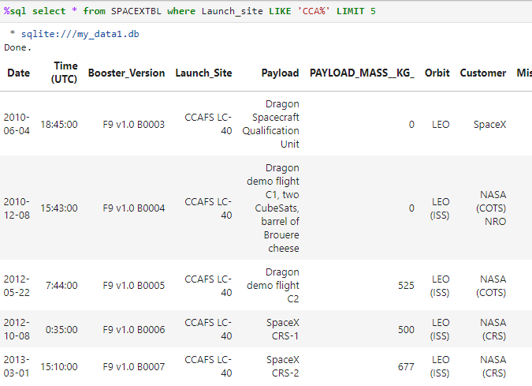
Launch Site Names Begin with 'CCA'
launch sites begin with `CCA`

Slide 24
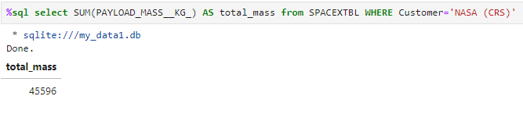
Total Payload Mass
the total payload carried by boosters from NASA

Slide 25
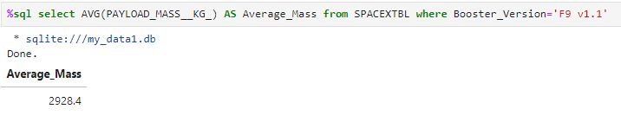
Average Payload Mass by F9 v1.1
The average payload mass carried by booster version F9 v1.1

Slide 26
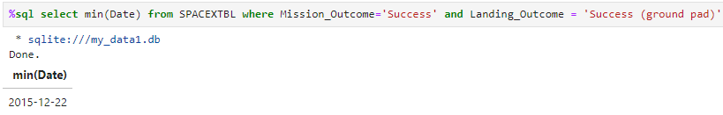
First Successful Ground Landing Date
The first successful landing outcome on ground pad

Slide 27
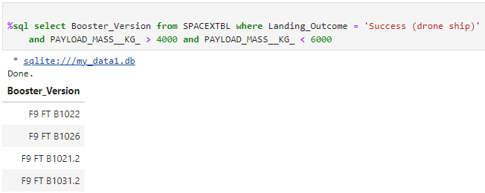
Successful Drone Ship Landing with Payload between 4000 and 6000
the names of boosters which have successfully landed on drone ship and had payload mass greater than 4000 but less than 6000

Slide 28
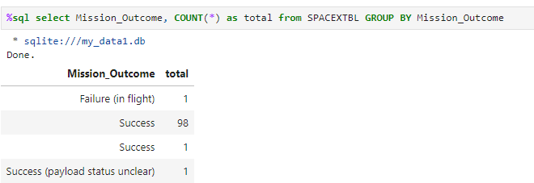
Total Number of Successful and Failure Mission Outcomes
The total number of successful and failure mission outcomes

Slide 29
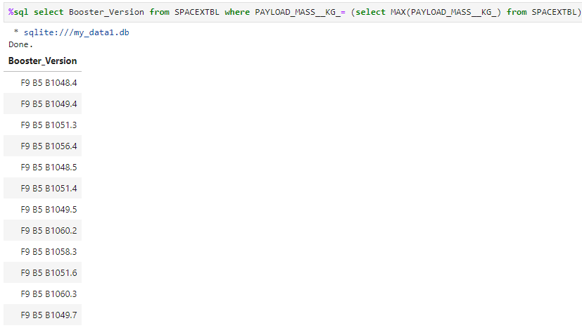
Boosters Carried Maximum Payload
The names of the booster which have carried the maximum payload mass

Slide 30
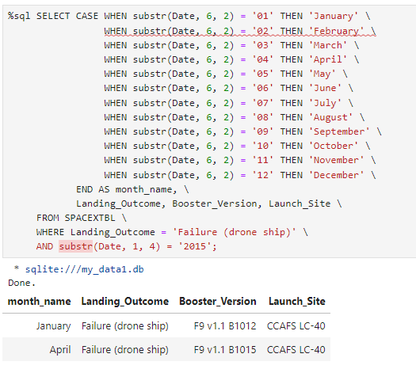
2015 Launch Records
List the failed landing_outcomes in
drone ship, their booster versions, and
launch site names for in year 2015

Slide 31
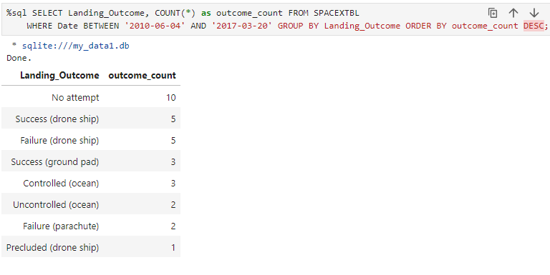
Rank Landing Outcomes Between 2010-06-04 and 2017-03-20
Rank the count of landing outcomes (such as Failure (drone ship) or Success (ground pad)) between the date 2010-06-04 and 2017-03-20, in descending order

Slide 32

Section 3

Slide 33
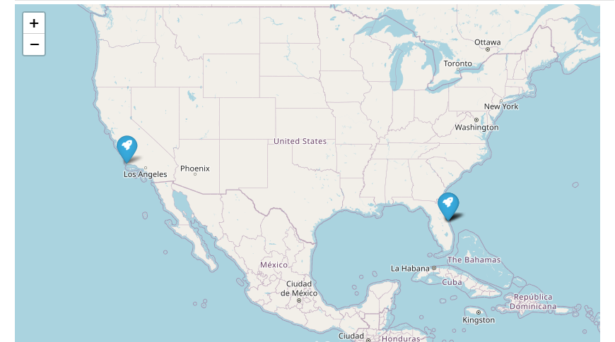
<Folium Map Screenshot 1>

Slide 34
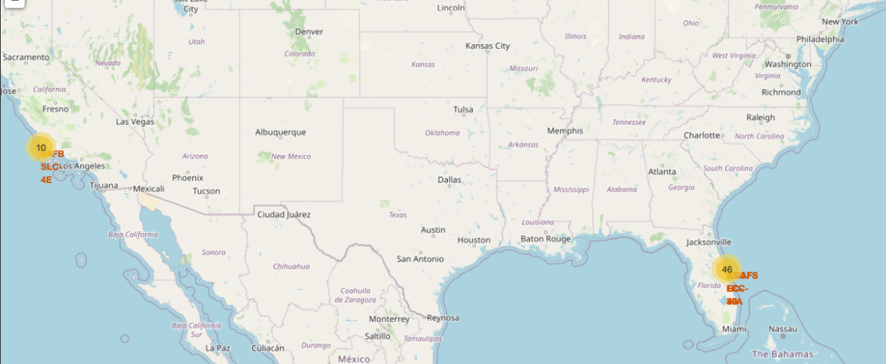
<Folium Map Screenshot 2>
Explore the folium map and make a proper screenshot to show the color-labeled launch outcomes on the map

Slide 35
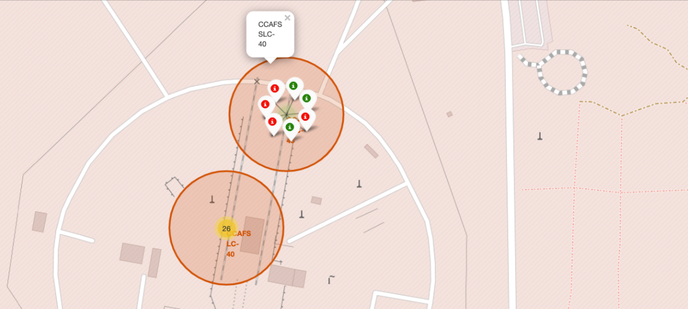
<Folium Map Screenshot 3>
Explore the generated folium map and show the screenshot of a selected launch site to its proximities such as railway, highway, coastline, with distance calculated and displayed

Slide 36

Section 5

Slide 37
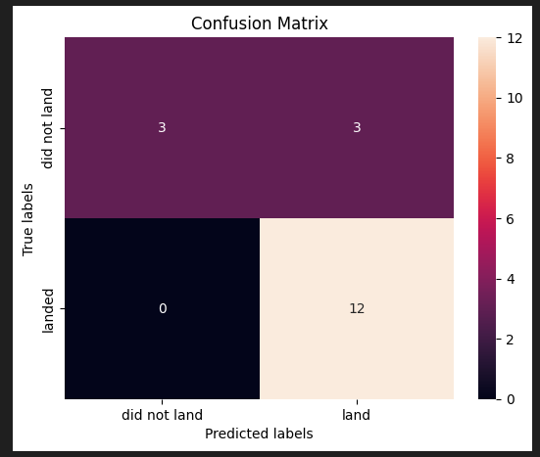
Confusion Matrix
The confusion matrix of the best performing model

Slide 38
Conclusions
Data-Driven Insights: The project successfully explored and analyzed SpaceX's Falcon 9 launches, providing valuable insights into factors influencing launch success rates, such as launch site locations, payload mass, and orbital trajectories.
Machine Learning Predictions: The predictive model developed to forecast Falcon 9's first-stage landing success performed with high accuracy, helping optimize SpaceX’s launch strategies and reduce costs. Random Forest, after hyperparameter tuning, proved to be the best-performing model.
Impact of Launch Sites: Analyzing the geographic locations of launch sites using interactive maps revealed patterns where certain launch sites had higher success probabilities, which could guide future launch planning decisions.
Future Improvements: Further refinement of the model with additional data, advanced feature engineering, and trying other algorithms (e.g., XGBoost) could enhance prediction accuracy and reliability.
Practical Applications: The insights and predictions from this analysis have the potential to be applied in real-world decision-making, helping SpaceX and other space agencies improve launch success rates and operational efficiency.

Slide 39


